Slide 1

Science Logic
SL1 Dist
API - DB
Raul Diez Canseco Christian Galarza

Slide 2

Overview
Distributed System
Upgrade 8.12 – 8.14
Review MariaDB
API - Get/Post/Delete
DataBase

Slide 3
overview
Help us with monitoring different kind of devices
Bring us information about their functionality in real-time
All over in a web site

Slide 4
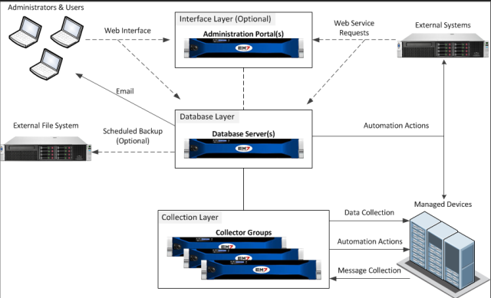
Distributed System
Distributed
Our Implementation
DB Server
API
Web Interface
Data Base
Collector Group
Data Collector
Message Collector

Slide 5
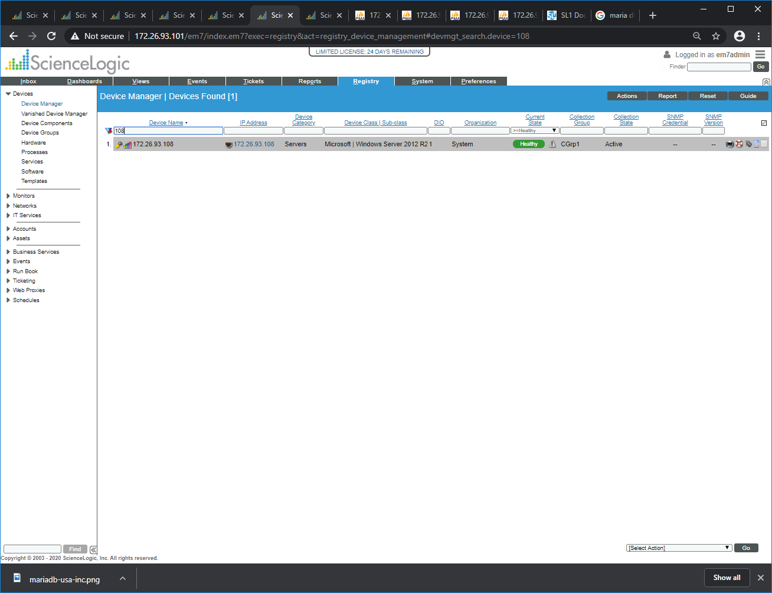
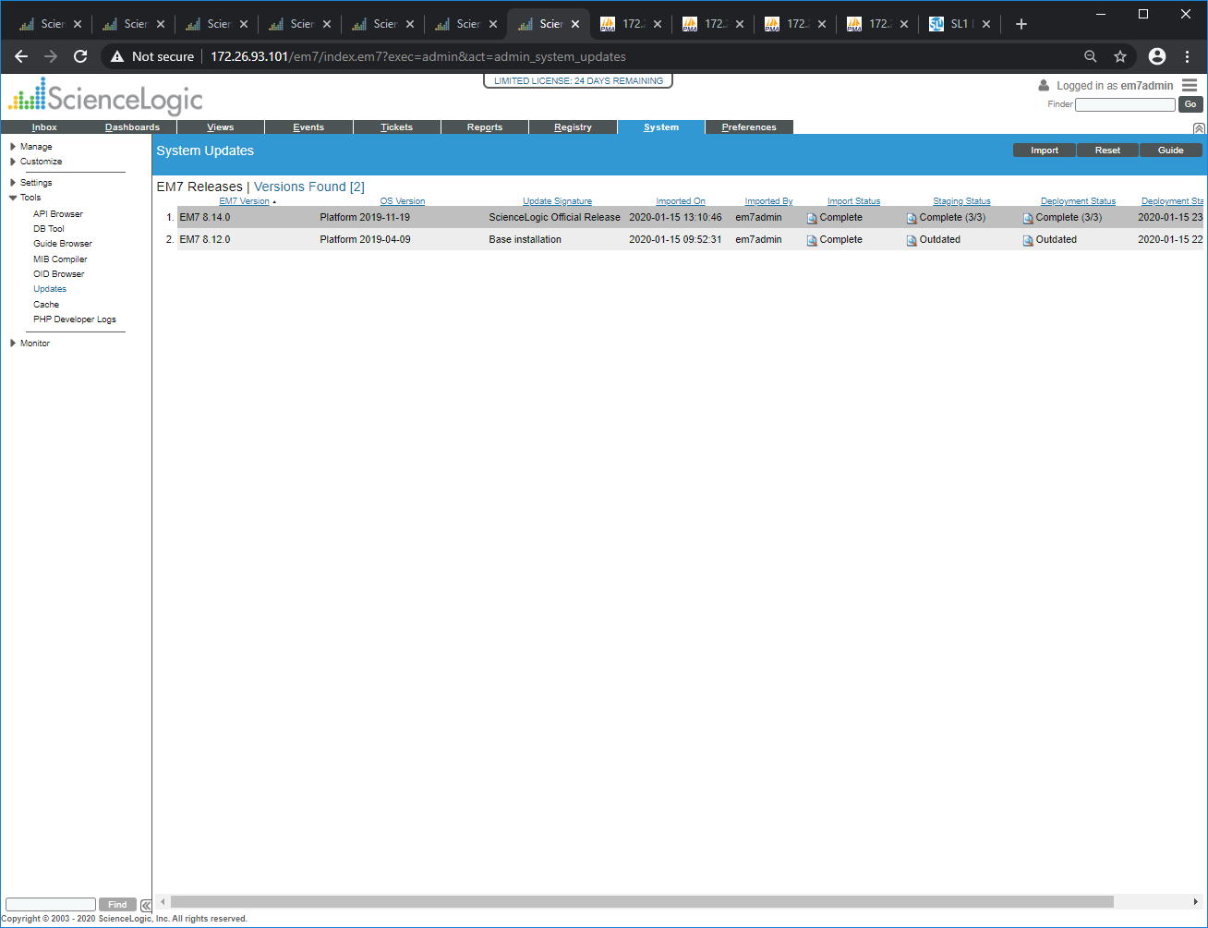
Upgrade 8.12 – 8.14

Slide 6

Review MariaDB
cd /tmp/
wget http://repository.auto.sciencelogic.local:8081/artifactory/script_store/rpm/8-14-0-mariadb-server-package/MariaDB-server-10.1.41-1.el7.centos.x86_64.rpm
sudo systemctl stop em7
sudo systemctl stop mariadb.service
sudo rpm -qa ^MariaDB-*
sudo rpm -Uvh MariaDB-server-10.1.41-1.el7.centos.x86_64.rpm
sudo rpm -qa ^MariaDB-*
sudo systemctl daemon-reload
sudo systemctl start mariadb.service
sudo mysql_upgrade -u root -p
sudo systemctl start em7

Slide 7
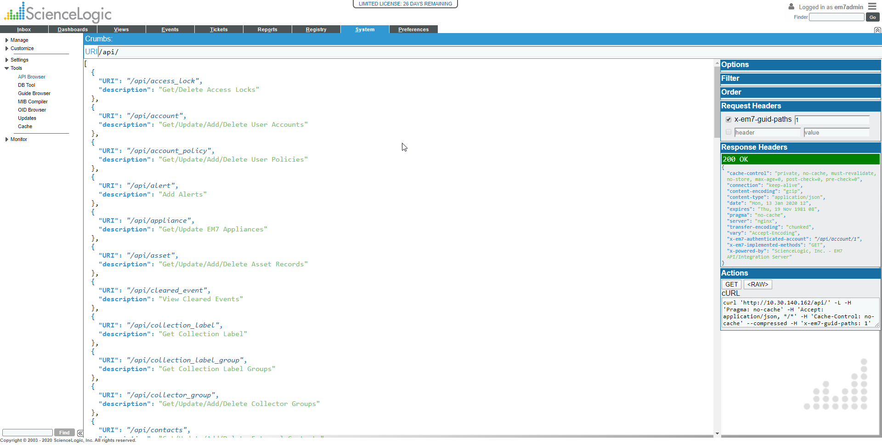
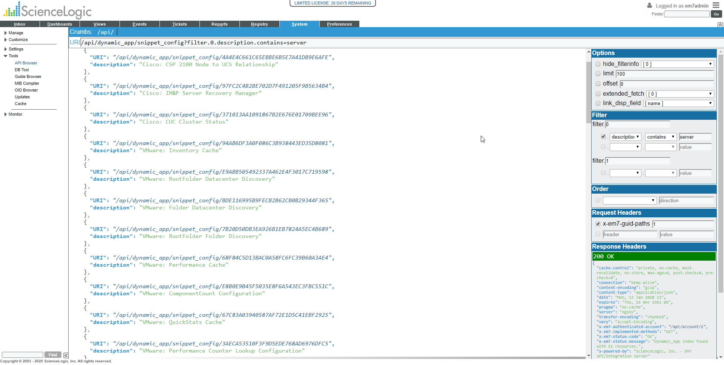
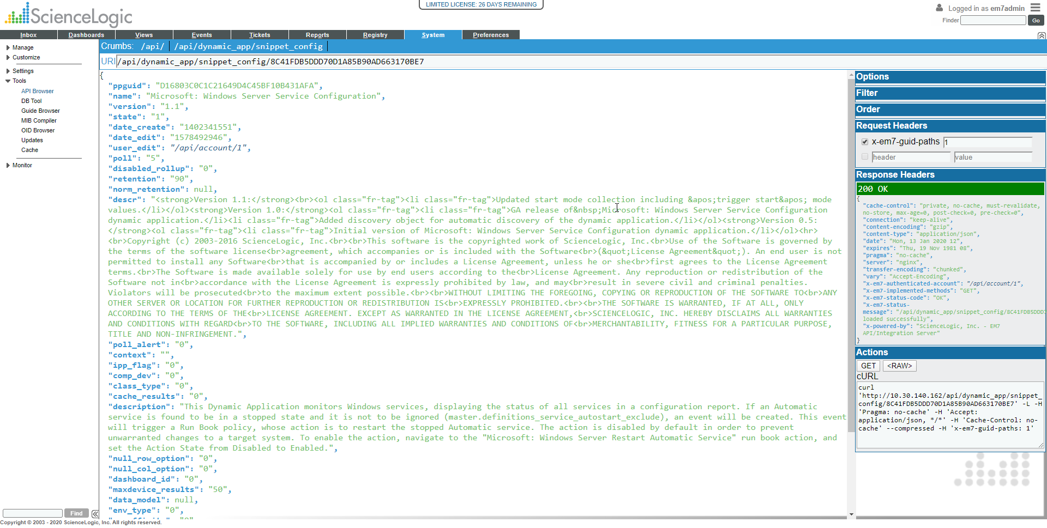
API - Get/Post/Delete

Slide 9
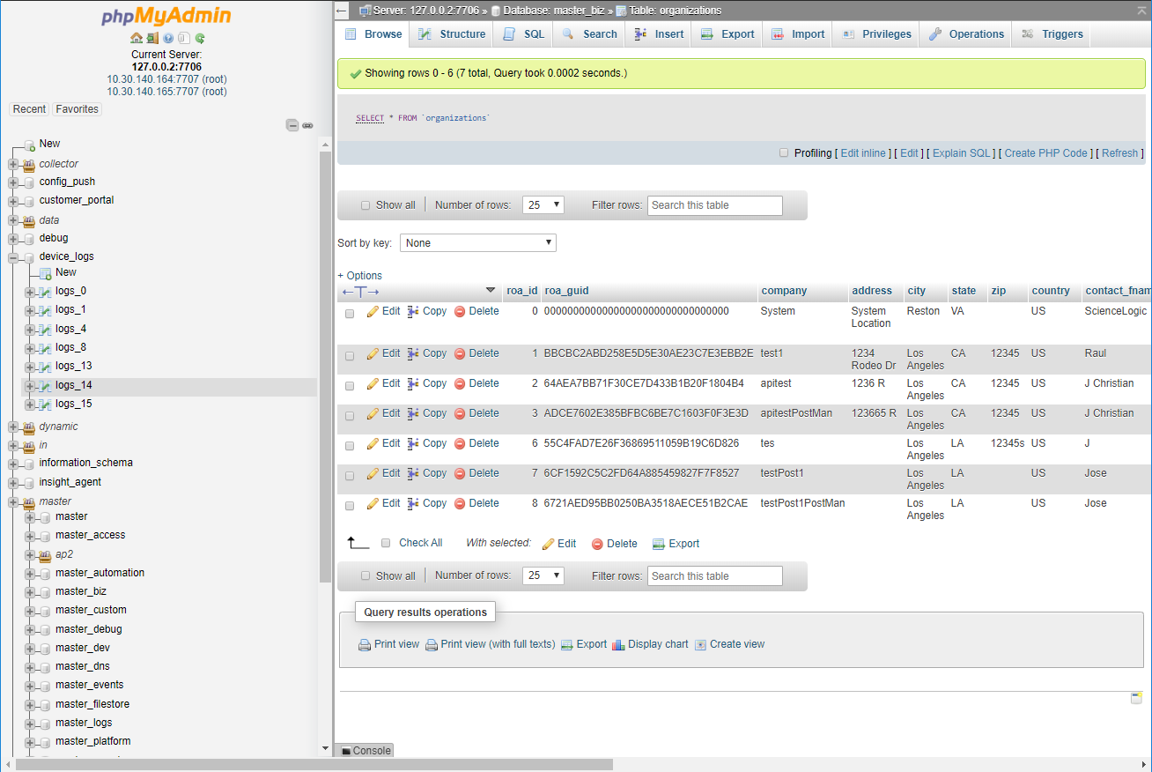
DataBase
Devices_Logs
Master / Master
Dynamic / App / Data /
Master / Master_biz
Master / Master_dev

Slide 10


Slide 11


